Slide 1
Personas
Getting to know your audience
Or
documenting users via personas
Notes:
The following slides are excerpted from Mulder, S ( 2007) Creating Personas from User Research

Slide 2
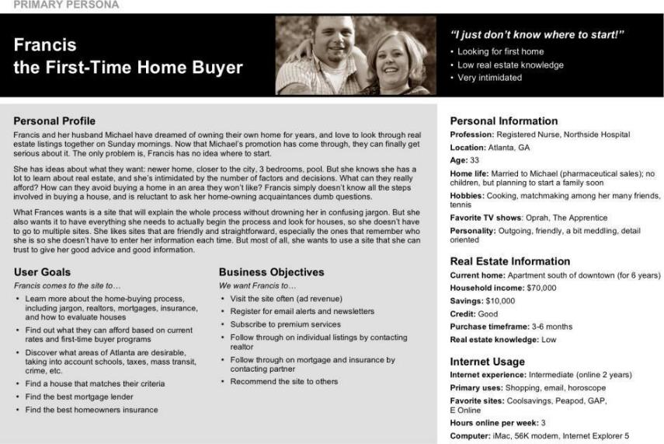
Personas

Slide 3

An example persona
Notes:
Francis: 33-year-old nurse living in Atlanta with her husband Michael
Dream of owning a home; browse real estate listings; open houses for fun
Michael got promoted, and Francis is excited; close to city, not a fixer-upper, 3+ bedrooms, ideally a pool
Completely intimidated, no idea where to start: How much can they afford? Process? Realtor? Neighborhood? Excitement turns to anxiety
Goes online to: 1) Learn about home-buying process, 2) Find what they can afford, 3) Learn about Atlanta neighborhoods, 4) Find houses matching criteria

Slide 4

Notes:
Realistic character sketch representing one segment of a site’s targeted audience
Archetype serving as a surrogate for entire group
Grounded in research, bring research to life and make it actionable
Defined by goals, behaviors, attitudes

Slide 5
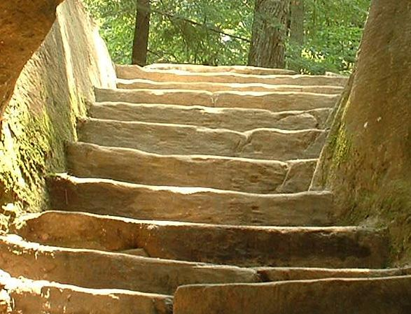
Decisions should be based on users
Knowledge about users must be actionable
Learning about users requires direct contact
You are not your user
Business results depend on satisfying users
Notes:
From Steve Mulder The user is always right
The Great Steps of User-Centered Design
Interaction with web site like a conversation/negotiation: Goal -> Content/Feature -> Business Result
Financial advisors example; Users have different goals than I have; Users don’t care like I do; Users aren’t all alike
User research is on the rise
Swimming in data, need to process it into: More forest than trees; Sharable; Memorable; Actionable
Decisions on: What you build; How it works; What you say; What it looks like

Slide 6
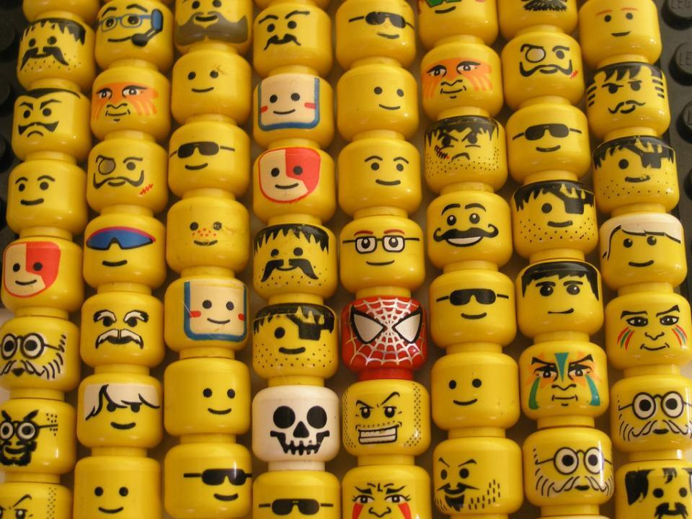
Personas bring focus
Notes:
You can’t create a site for everyone
Focus on which types of users are most important

Slide 7

Personas build empathy
Notes:
You are not your user, so you’ll need to learn to walk in someone else’s shoes for a while.

Slide 8
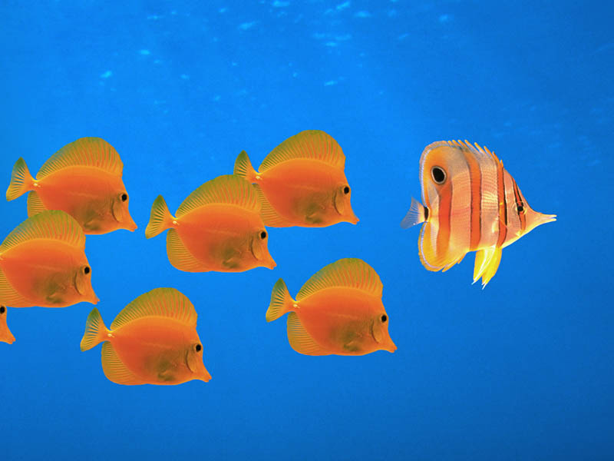
Personas encourage consensus
Notes:
Shared vision of who you’re targeting, what they need, and how to provide this for them.
Personas help your team to all travel in the right direction – together.

Slide 9

Personas create efficiency
Notes:
Clearly understanding your audience will save you precious time.
Each decision needs a tool (wireframes, mockups)
Make key decisions earlier to avoid wasting time later (e.g., in design review)

Slide 10

Personas lead to better decisions
Personas for Strategy
Framework for business decisions, offerings, channel usage, features
Personas for Marketing
Framework for marketing campaigns, branding, messaging, market research
Personas for Design
Information architecture, interaction design, visual design, content development, user testing
Notes:
Personas encourage everyone to think about actual users throughout entire process

Slide 11

Making Personas Real
Notes:
Image courtesy of Open ClipArt

Slide 12

Components of a persona
Profile
User goals
Business objectives
Personal information

Slide 13
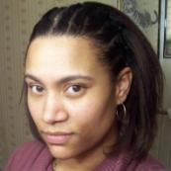
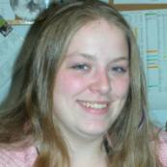
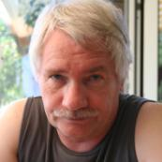


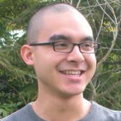
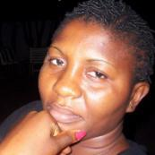
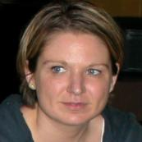



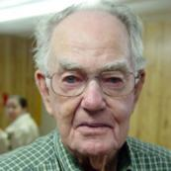
Photo
www.sxc.hu www.morguefile.com www.istockphoto.com
Notes:
Use photos of real people, not models
Not overly posed
Think about clothing, hairstyle, makeup, diversity.
The photo that you choose for your persona should match the story you create.

Slide 14
Create a scenario about how your persona will interact with your site
Francis and Michael have agreed that she’ll take charge of learning more about the home-buying process. She goes online, does a Google search for “Atlanta real estate,” and follows a link to the site’s home page. She sees that she can search for houses from the home page, so just for fun, she does a quick Atlanta search to see what kinds of houses show up. There are lots of houses in many different neighborhoods, and she easily narrows her results down to the area where she and Michael live, using a map. There are still many results, and she’s not quite sure which search options to use to narrow the search further. Then she notices a link for first-time home buyers and follows, it hoping for basic how-to information.
The link takes Francis to a step-by-step tutorial that explains the whole process, and she immediately feels like she’s found the right site from which to begin her house search. She carefully reads some articles for first-time home buyers, taking notes as she reads. She bookmarks other articles she wants to go back and read later. She also comes across the site’s calculator and starts trying different combinations of numbers to find out what she and Michael can afford. She particularly likes the glossary of terms so that she can finally figure out what “points” are and learn more about different types of mortgages. After an hour and a half of reading, her brain is full, and she shuts her computer down for the day, feeling like she got an excellent start.
The next day, she comes back to the site to look up information specific to Atlanta neighborhoods and finds lots of information on each. She’s able to focus on five neighborhoods that look particularly good. The fun begins that night, when she takes Michael through all that she has learned, and they set up a regular schedule for looking at online house listings.
Notes:
Stories of how persona interacts with site
Idealistic
Use principles of good storytelling

Slide 15


Using personas
Notes:
Images courtesy of Open ClipArt

Slide 16
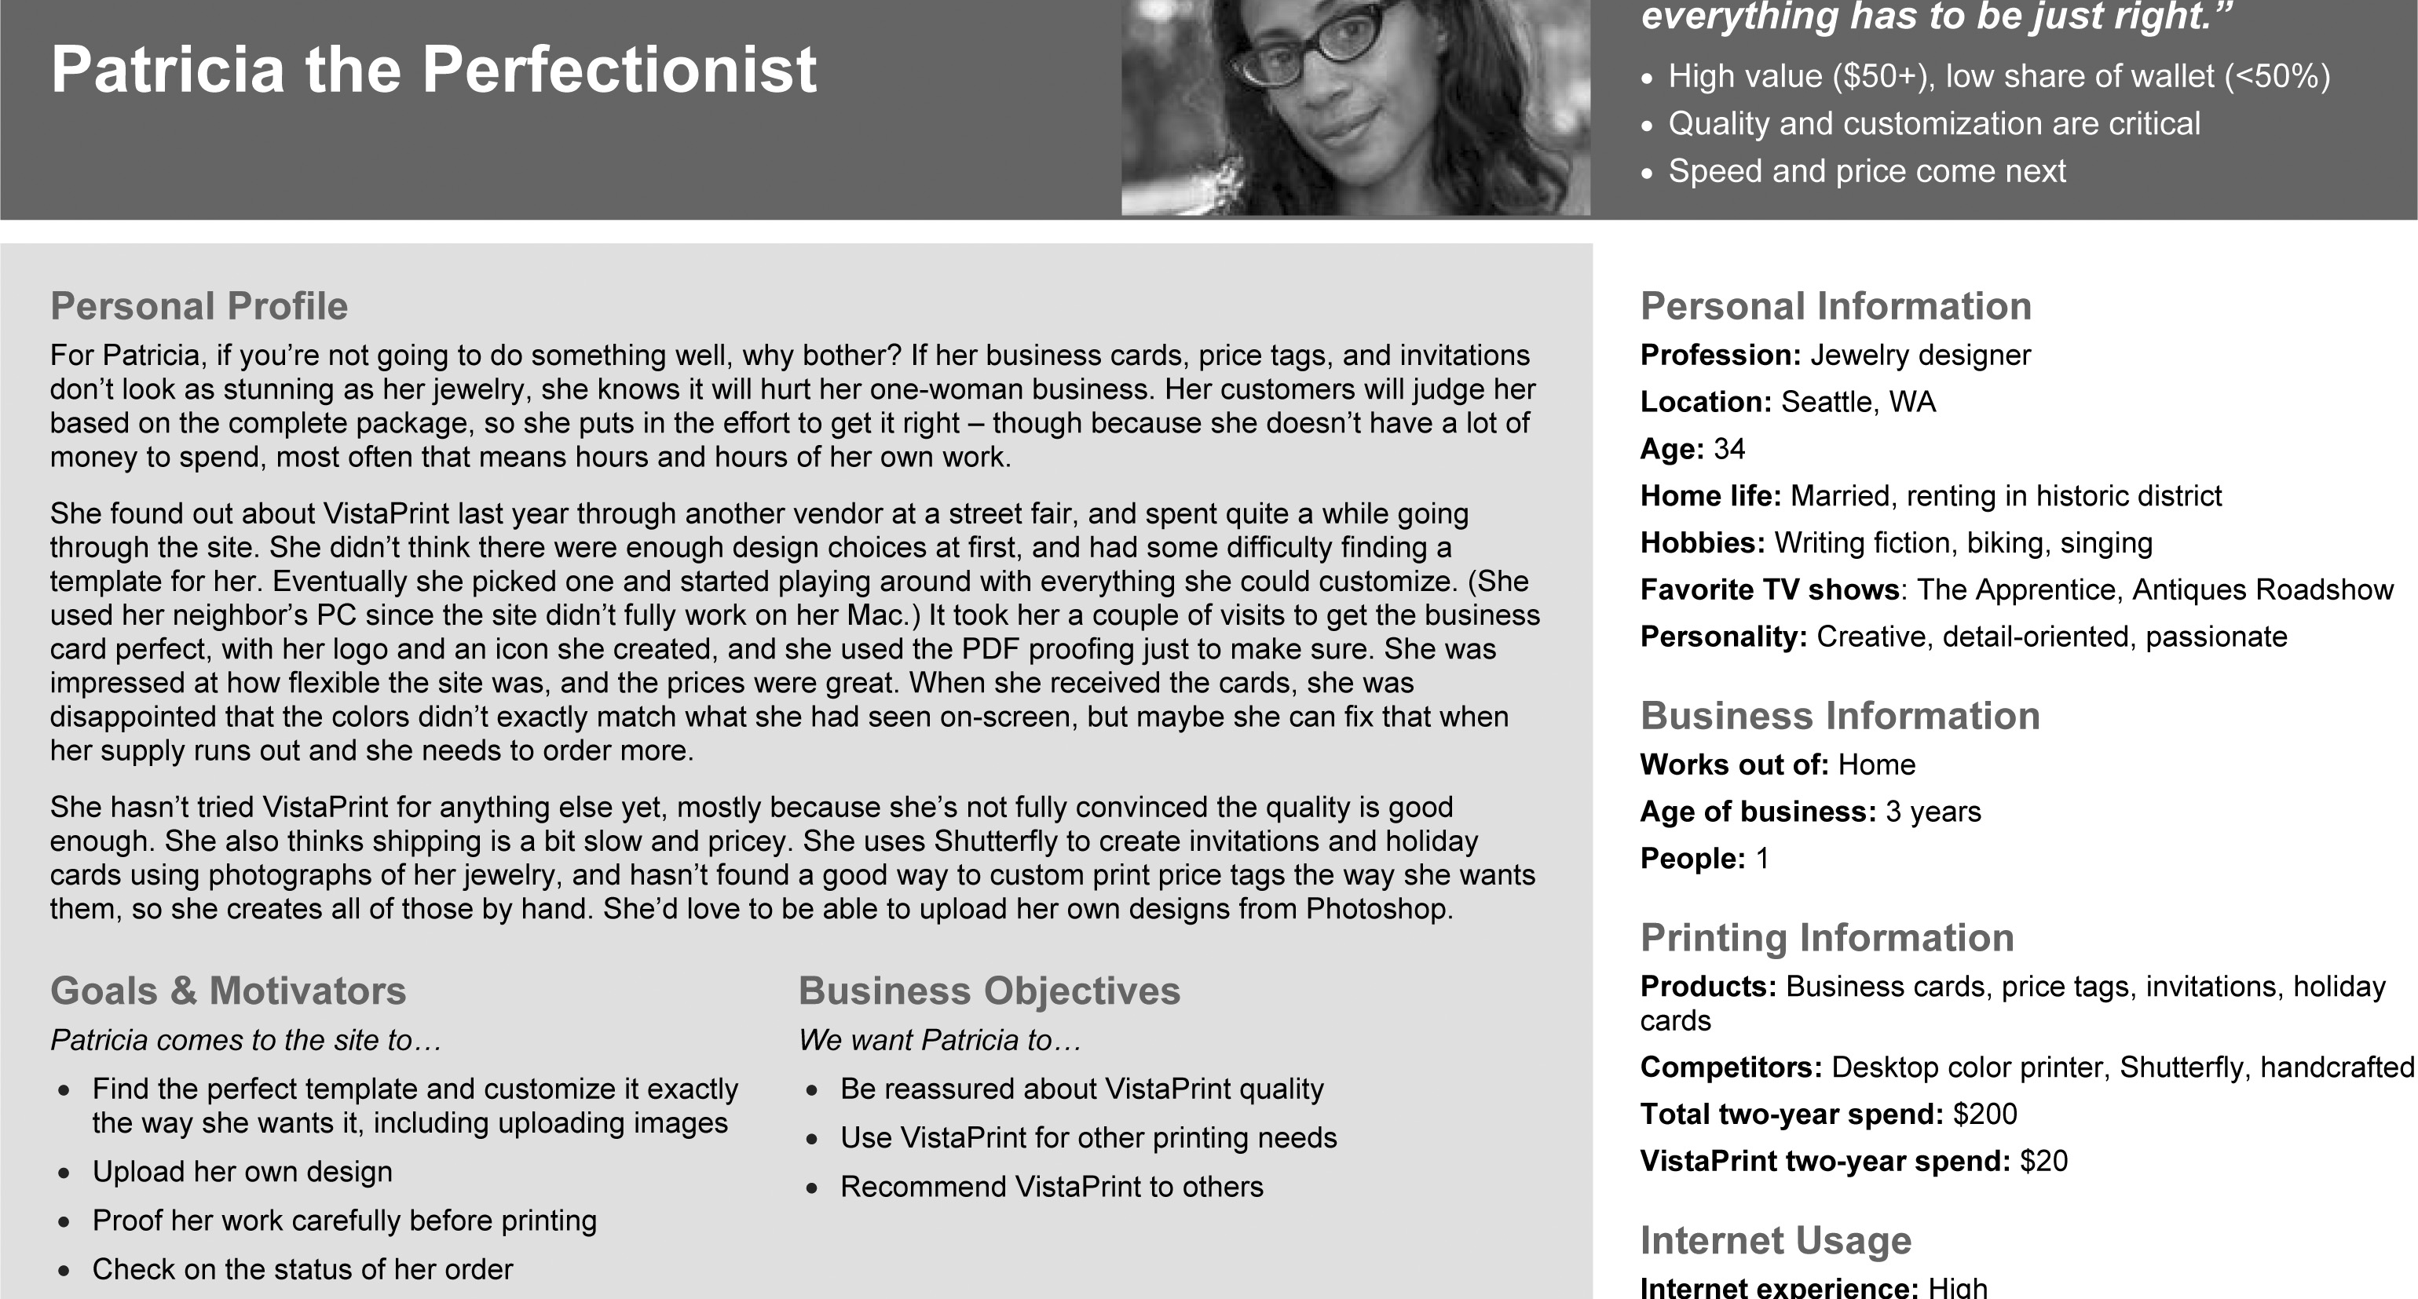
The persona document – a single page
Notes:
Complete version of persona
One page.
A template document is available in Learnline under this powerpoint.

Slide 17
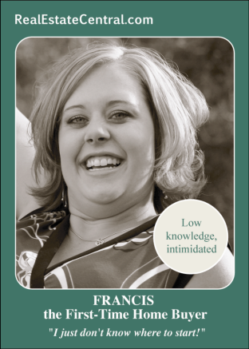
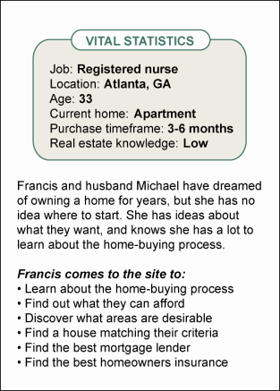
The persona document – a card
Notes:
This is an alternative way to do a persona – you still need to include all the same info as a single page document though.
It isn’t a short-cut.

Slide 18
Features and Functionality
What goes into the persona

Slide 19
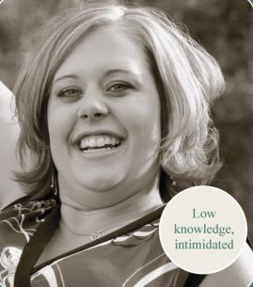
Some ideas from Francis...
Francis’ Goals
Learn about the home-buying process
Find out what she can afford
Discover what areas of Atlanta are desirable
Find a house that matches her criteria
Notes:
What exactly does Francis want to get out of the site.

Slide 20
More ideas about Francis...
Possible Features and Content Francis is looking for
Introductory how-to articles
Glossary of jargon
Videos and podcasts
Success stories
Q&A with experts
Message board
Blogs
Rent vs. own calculator
Local experts to call/meet
Checklists to print
Interactive quizzes
Common mistakes
Animated cartoons
Book recommendations
Notes:
What might Francis be looking to find on a real estate site.
This relates directly to the type of content that should be in the site.

Slide 21
Still more ideas about Francis...
Business Objectives: what does the site owner want Francis to do?
Visit the site often
Register for email alerts and newsletters
Subscribe to premium services
Recommend the site to others
Notes:
What are the long-term goals you have for Francis where your site is concerned?

Slide 22
Now prioritize your features & functionality
Remember what you found through your competitive benchmarking
Use this knowledge when building your persona
Would the persona consider this aspect of your site a baseline expectation or a nice-to-have?
Would the persona consider this a differentiator between using your site or another similar site?
How often would the persona use this feature?
How effectively would this drive the persona toward your business objectives?
Notes:
Go back to your competitive benchmarking and see what the good sites have.
Match this against what your persona would want.

Slide 23
Using Personas
The structure of your site should match how the primary and then secondary users will mostly likely navigate through it.

Slide 24
Task Analysis
Search for houses from home page
Enter location by city and state, or zip code
Enter price range
Enter number of bedrooms and/or bathrooms
Submit search
View and narrow results
Browse first page of results: photo, price, address, basic stats, and description
Click to show results on map
Click map to narrow results to one neighborhood
Browse new results
Read tutorial
Click link for first-time home buyers
Read landing page for learning area
Click teaser for step-by-step tutorial
And so on…
Notes:
This is an example of a task that Francis (our user) could perform on a real estate site.
Connect the dots: User research – Segments – Personas – Scenarios – Task analysis/use cases – Feature design
The structure of the site will affect how the user can perform the task.

Slide 25
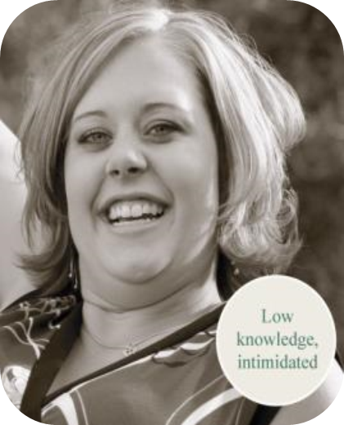
Use Cases
Search for Houses
Level: User goal
Primary
Preconditions:
Francis arrives at home page or House Search landing page
Main success scenario:
Francis enters city and state or zip code.
System uses auto-completion to show options below search field as Francis types. System shows up to 10 matching city names in order of number of homes for sale in each city. Francis can click a city name to select that city.
Francis selects minimum and maximum price values from drop-down menus.
System validates selected values.
Francis selects number of bedrooms and bathrooms from drop-down menus.
Francis submits search.
System validates required fields before submitting query.
Notes:
The system (the site) has actions as well as the user.
You should understand both sides of use.
And they should complement each other.

Slide 26
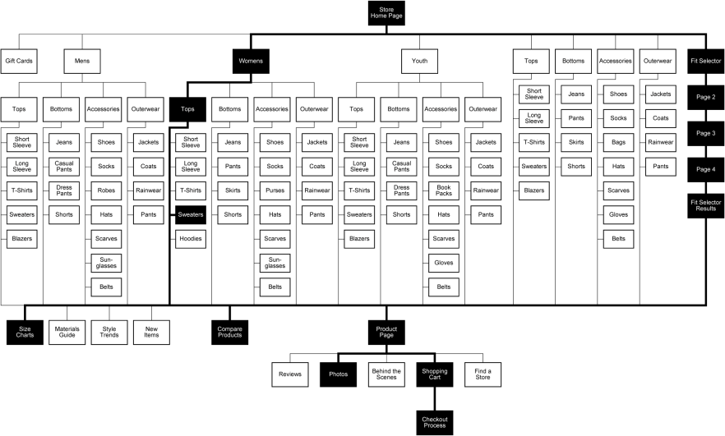
Structuring information
Notes:
You should know the pathways that users will take through your site’s structure and change the structure if it isn’t easy and intuitive for the user.

Slide 27
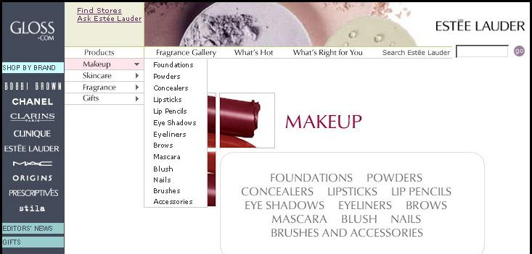
Checking navigation
Notes:
Support personas’ core paths through site
Establish where each persona needs to go from each type of page
Labeling appropriate to personas.
Understanding how your persona will move through your site will help you define the architecture of your site.

Slide 28
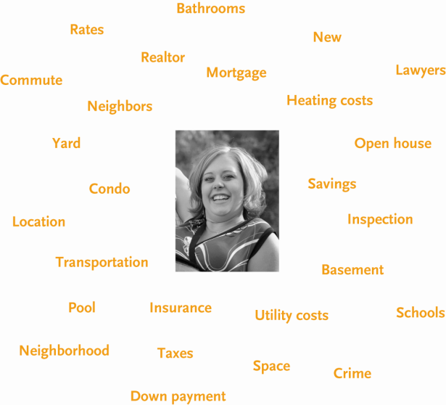
Creating keywords: try a word cloud
Notes:
It can be a good idea to brainstorm the keywords that will be included in your site – you don’t want to miss anything and also want to get your content correct.
A word cloud or mind map can be very useful for this.

Slide 29

Peronas influence your design: Mood Board
Start putting together a potential design scheme for your site
Look at other sites and see what they’ve done successfully
DON’T COPY IMAGES
BUY THEM
https://interactiveking.files.wordpress.com/2011/03/johnny-smith-the-persona-man.jpg

Slide 30
Design
Your design should appeal to all users
Don’t design for yourself
Don’t be extreme
Again, look at what others have done that is successful
Notes:
Nancy the Nervous: trust and easy; reassurance through color, typography, photo
Harry the Hurried: speed; exposure to all types of products for fast access
Don’t lock out potential users through an extreme design choice.

